Slide 1
Capstone Project The Battle Of Neighbourhoods
Presentation AnuJ KuMar Agrawal

Slide 2
Introduction
Background
Safety is a top concern when moving to a new area
Problem
This project aims to select the safest borough in London based on the total crimes, explore the neighbourhoods of that borough to find the 10 most common venues in each neighborhood and finally cluster the neighbourhoods using k-mean clustering.
Interest
Expats who are considering to relocate to London will be interested to identify the safest borough in London and explore its neighbourhoods and common venues around each neighborhood.

Slide 3
Data Acquisition and Cleaning
The data acquired for this project is a combination of data from three sources.
The first data source of the project uses a ​London crime data​ that shows the crime per borough in London.
The second source of data is scraped from a Wikipedia page that contains the ​list of London boroughs​.
The third data source is the ​list of Neighbourhoods in the Royal Borough of Kingston upon Thames​ as found on a Wikipedia page. This dataset is created from scratch using the list of neighbourhood available on the site

Slide 4
Data Cleaning
The data preparation for each of the three sources of data is done separately. From the London crime data, the crimes during 2016 are only selected. The major categories of crime are pivoted to get the total crimes per the boroughs for each major category.
The second data is scraped from a Wikipedia page using the ​Beautiful Soup​ library in python.
The two datasets are merged on the Borough names to form a new dataset that combines the necessary information in one dataset
The third source of data is acquired from the list of neighbourhoods in the safest borough on Wikipedia
The new dataset is used to generate the 10 most common venues for each neighbourhood using the Foursquare API, finally using k means clustering algorithm to cluster similar neighbourhoods together

Slide 5
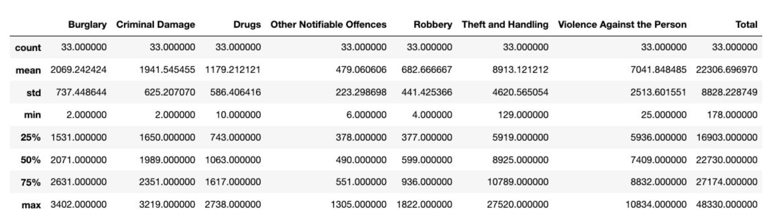
Methodology
Exploratory Data Analysis
Statistical Summary of Crimes
The count for each of the major categories of crime returns the value 33 which is the number of London boroughs. ‘Theft and Handling’ is the highest reported crime during the year 2016 followed by ‘Violence against the person’, ‘Criminal damage’. The lowest recorded crimes are ’Drugs’, ‘Robbery’ and ‘Other Notifiable offenses’.

Slide 6
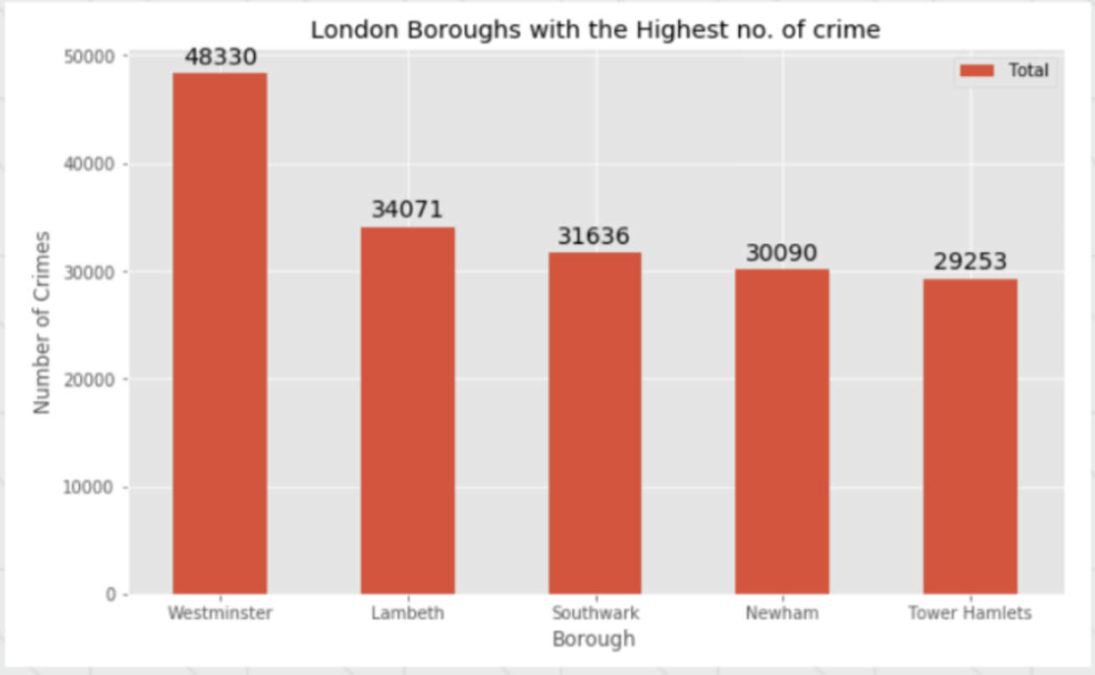
Boroughs with the highest crime rates
Comparing five boroughs with the highest crime rate during the year 2016 it is evident that Westminster has the highest crimes recorded followed by Lambeth, Southwark, Newham.

Slide 7
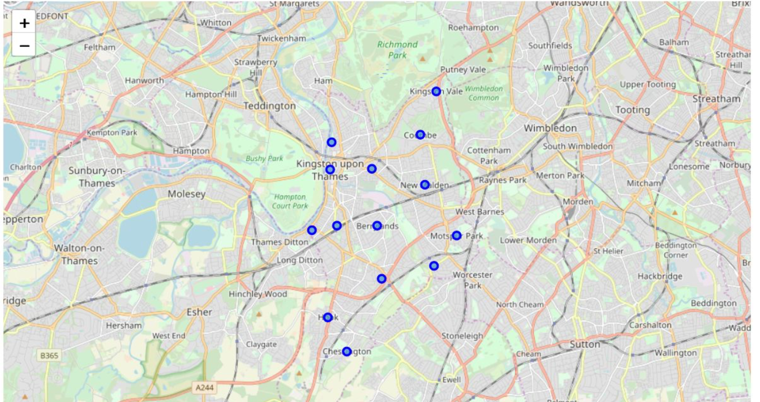
Neighbourhoods in Kingston upon Thames

Slide 8
Modelling
Using the final dataset containing the neighbourhoods in Kingston upon Thames along with the latitude and longitude, we can find all the venues within a 500 meter radius of each neighbourhood by connecting to the Foursquare API
One hot encoding is done on the venues data.
To help people find similar neighbourhoods in the safest borough we will be clustering similar neighbourhoods using K - means clustering which is a form of unsupervised machine learning algorithm that clusters data based on predefined cluster size. We will use a cluster size of 5 for this project that will cluster the 15 neighbourhoods into 5 clusters

Slide 9
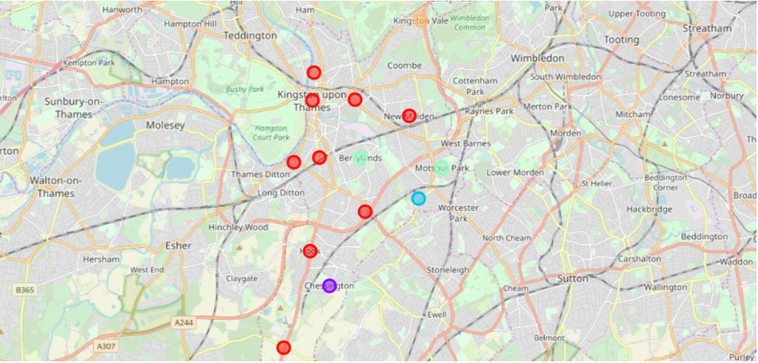
Results
After running the K-means clustering we can access each cluster created to see which neighbourhoods were assigned to each of the five clusters.
Each cluster is color coded for the ease of presentation, we can see that majority of the neighbourhood falls in the red cluster which is the first cluster.

Slide 10
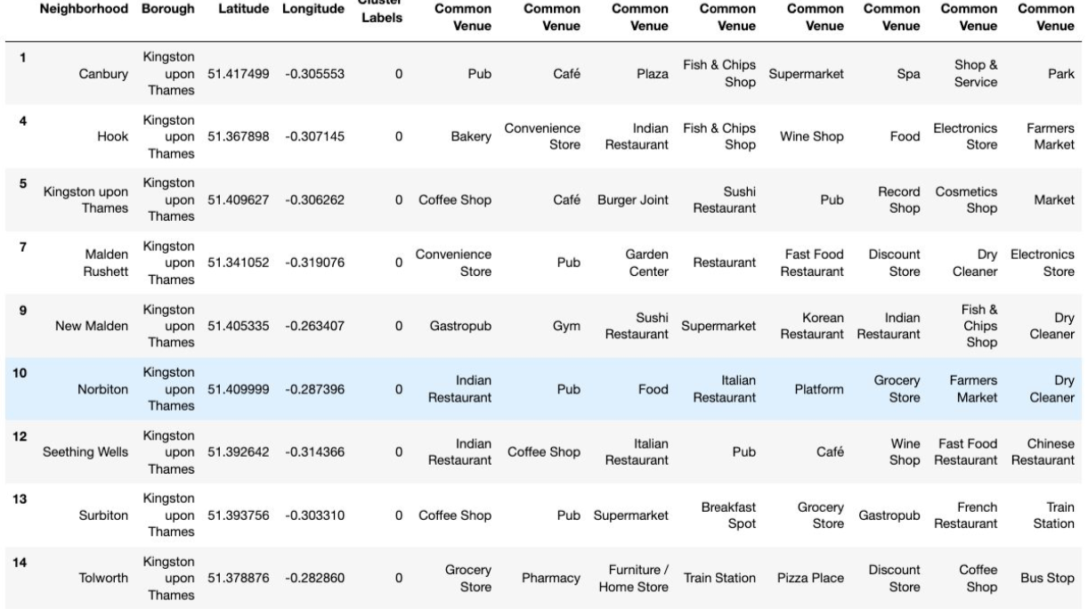
Cluster-1
The cluster one is the biggest cluster with 9 of the 15 neighbourhoods in the borough Kingston upon Thames.
Upon closely examining these neighbourhoods we can see that the most common venues in these neighbourhoods
are Restaurants, Pubs, Cafe, Supermarkets, and stores.

Slide 11
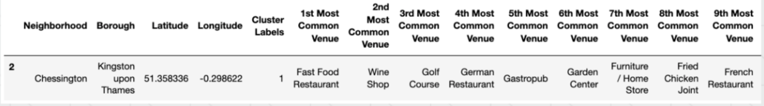
Cluster-2
The second cluster has one neighbourhood which consists of Venues such as Restaurants, Golf courses, and wine shops.

Slide 12
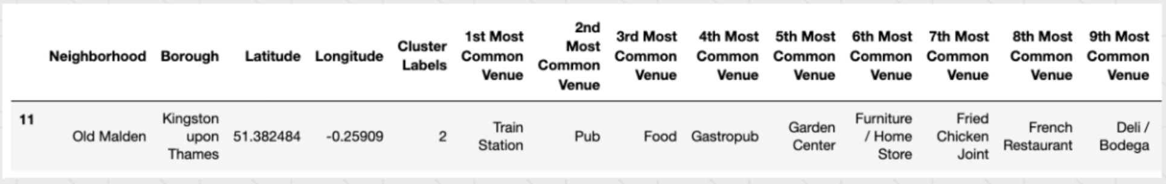
Cluster-3
The third cluster has one neighbourhood which consists of Venues such as Train stations, Restaurants, and
Furniture shops.

Slide 13
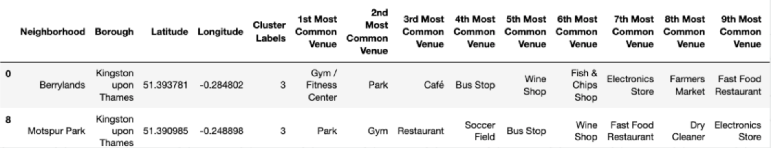
Cluster-4
The fourth cluster has two neighbourhoods in it, these neighbourhoods have common venues such as
Parks, Gym/Fitness centers, Bus Stops, Restaurants, Electronics Stores and Soccer fields etc.

Slide 14
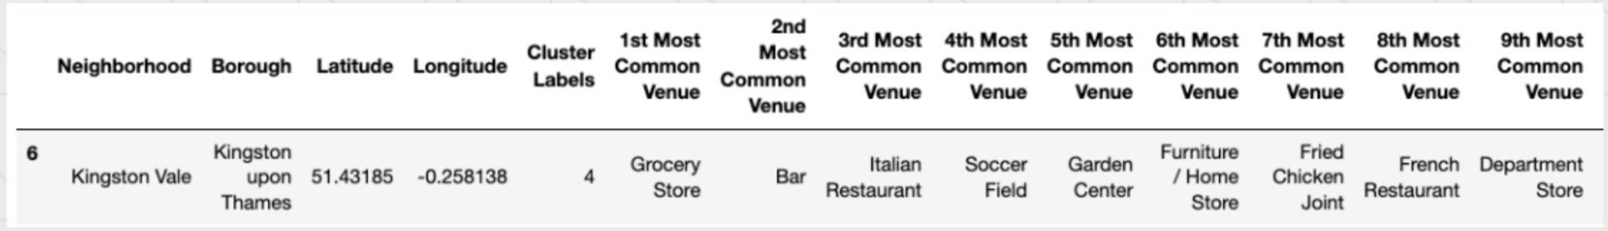
Cluster - 5
The fifth cluster has one neighbourhood which consists of Venues such as Grocery shops, Bars, Restaurants,
Furniture shops, and Department stores. We will look into the neighbourhoods in the fourth cluster

Slide 15
Discussion
The aim of this project is to help people who want to relocate to the safest borough in London, expats can chose the neighbourhoods to which they want to relocate based on the most common venues in it.
For example if a person is looking for a neighbourhoods with good connectivity and public transportation we can see that Clusters 3 and 4 have Train stations and Bus stops as the most common venues. If a person is looking for a neighbourhoods with stores and restaurants in a close proximity then the neighbourhoods in the first cluster is suitable.
For a family I feel that the neighbourhoods in Cluster 4 are more suitable dues to the common venues in that cluster, these neighbourhoods have common venues such as Parks, Gym/Fitness centers, Bus Stops, Restaurants, Electronics Stores and Soccer fields which is ideal for a family. The choices of neighbourhoods may vary from person to person.

Slide 16
Conclusion
This project helps a person get a better understanding of the neighbourhoods with respect to the most common venues in that neighbourhood.
It is always helpful to make use of technology to stay one step ahead i.e. finding out more about places before moving into a neighbourhood.
We have just taken safety as a primary concern to shortlist the safest borough of London. The future of this project includes taking other factors such as cost of living in the areas into consideration to shortlist the borough, such as filtering areas based on a predefined budget.

